Slide 1
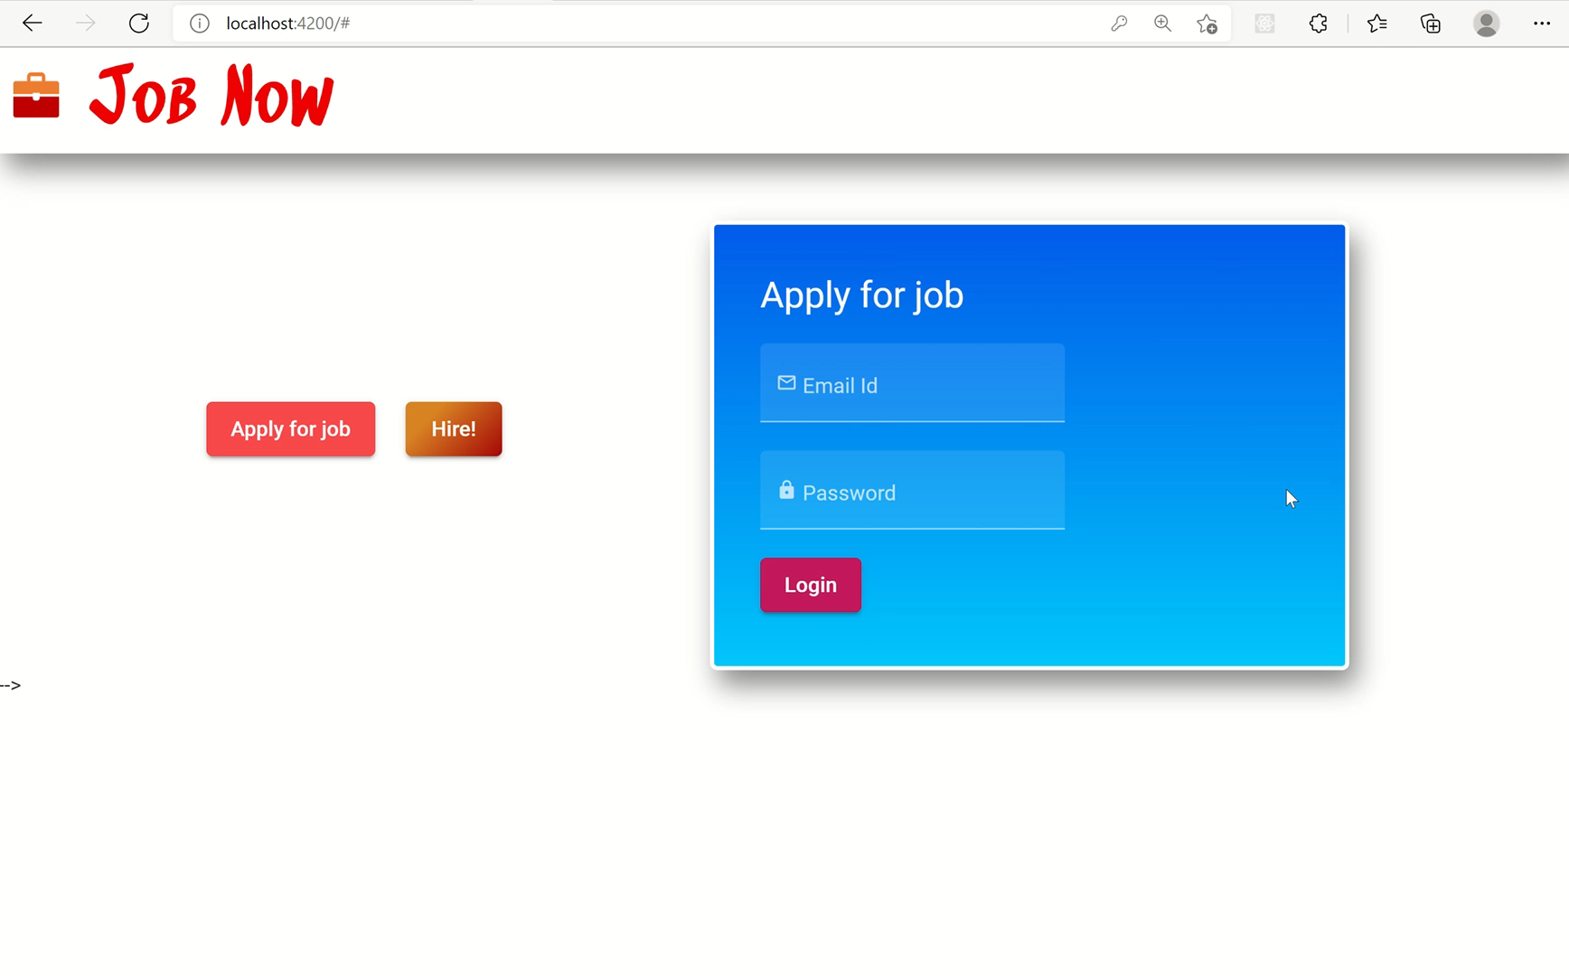
Login Page
Candidate Profile Page
Candidate Jobs Page
To see list of all jobs posted by recruiter
Candidate can view and apply for jobs
Recruiter Login Page

Slide 2
JobNow.com

